Slide 1
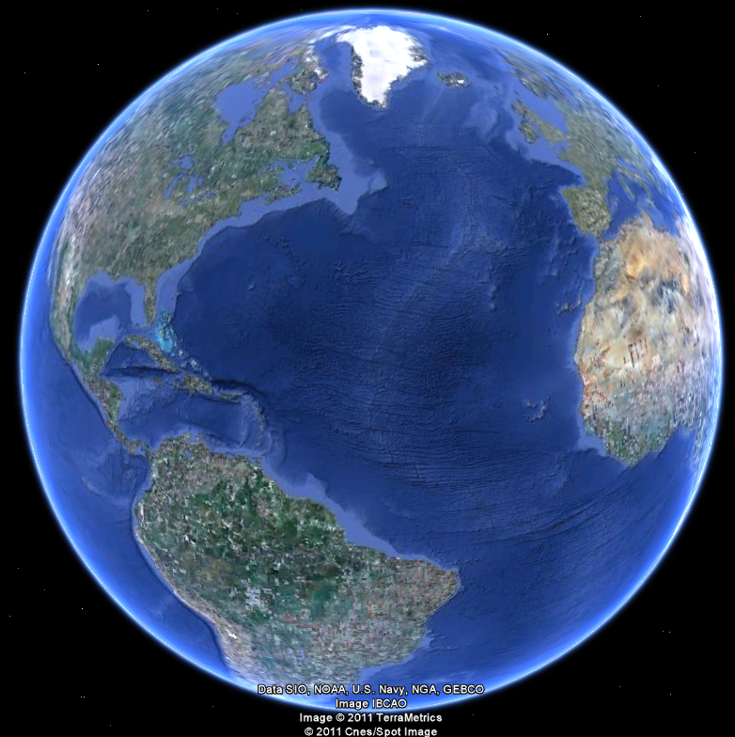
APEC 100 Sustainable Development
What is Sustainable Development
and Sustainability Science?

Slide 2
What is Sustainable Development?
According to the World Commission of Environment and Development (1987)
Sustainable Development is…
“…development that meets the needs of the present without compromising the ability of future generations to meet their own needs.“

Slide 3
What is Sustainable Development?
Can communities, societies, and nations be sustained without destroying the natural resource base needed for their future?
Answer depends on…
Natural resource processes—predominately ecological
Social processes—economic and political
Also referred to as anthropogenic (“caused or produced by humans”)
We will investigate this issue throughout the semester by looking at the trade-offs associated with development and environmental protection

Slide 4
Challenges with the term Sustainable Development
…"development that meets the needs of the present without compromising the ability of future generations to meet their own needs.“

Slide 5
Core Questions of Sustainability Science (Kates et al. 2001)
How can the dynamic interactions between nature and society – including lags and inertia – be better incorporated in emerging models and conceptualizations that integrate the Earth system, human development, and sustainability?
How are long-term trends in environment and development, including consumption and population, reshaping nature-society interactions in ways relevant to sustainability?
What determines the vulnerability or resilience of the nature-society system in particular kinds of places and for particular types of ecosystems and human livelihoods?

Slide 6
Core Questions of Sustainability Science (Kates et al. 2001)
Can scientifically meaningful “limits” or “boundaries” be defined that would provide effective warning of conditions beyond which the nature-society systems incur a significantly increased risk of serious degradation?
What systems of incentive structures – including markets, rules, norms and scientific information– can most effectively improve social capacity to guide interactions between nature and society toward more sustainable trajectories?
How can today’s operational systems for monitoring and reporting on environmental and social conditions be integrated or extended to provide more useful guidance for efforts to navigate a transition toward sustainability?
How can today’s relatively independent activities of research planning, monitoring, assessment, and decision support be better integrated into systems for adaptive management and societal learning?

Slide 7
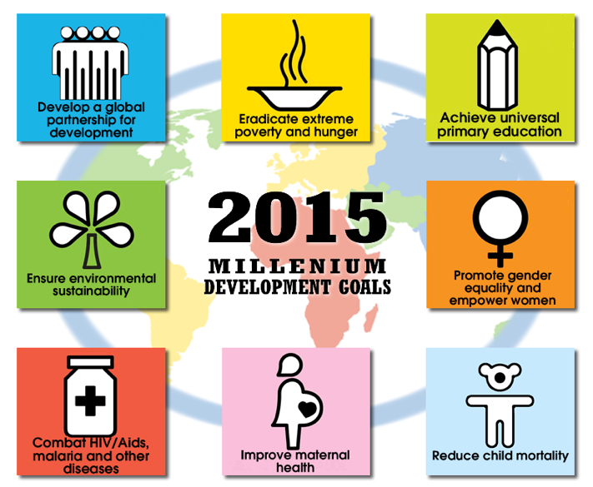

Slide 8
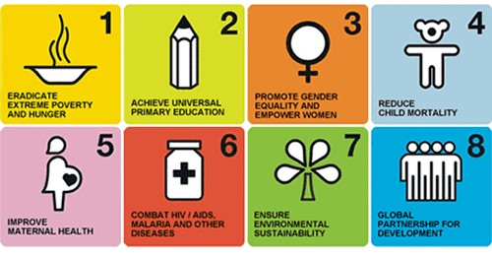
Millennium Goals
1. Eradicate extreme poverty and hunger
Reduce by half the proportion of people whose income is less than $1 a day
Achieve full and productive employment and decent work for all, including women and young people
Reduce by half the proportion of people who suffer from hunger
2. Achieve universal primary education
Ensure that all boys and girls complete a full course of primary schooling
3. Promote gender equality and empower women
Eliminate gender disparity in primary and secondary education preferably by 2005, and in all levels of education no later than 2015

Slide 9
Millennium Goals
4. Reduce child mortality
Reduce by two thirds the mortality of children under five
5. Improve maternal health
Reduce maternal mortality by three quarters
Achieve universal access to reproductive health
6. Combat HIV/AIDS, malaria and other diseases
Halt and reverse the spread of HIV/AIDS
Achieve, by 2010, universal access to treatment for HIV/AIDS for all those who need it
Halt and reverse the incidence of malaria and other major diseases

Slide 10
Millennium Goals
7. Ensure environmental sustainability
Integrate principles of sustainable development into country policies and programs; reverse the loss of environmental resources
Reduce biodiversity loss, achieving, by 2010, a significant reduction in the rate of loss
Halve the proportion of people without access to safe drinking water and basic sanitation
Improve the lives of at least 100 million slum dwellers by 2020

Slide 11
Millennium Goals
8. Develop a global partnership for development
Develop further an open, rule-based, predictable, non-discriminatory trading and financial system
Address special needs of the least developed countries, landlocked countries and small island developing States
Deal comprehensively with developing countries’ debt
In cooperation with pharmaceutical companies, provide access to affordable essential drugs in developing countries
In cooperation with the private sector, make available the benefits of new technologies, especially information and communications technologies

Slide 12
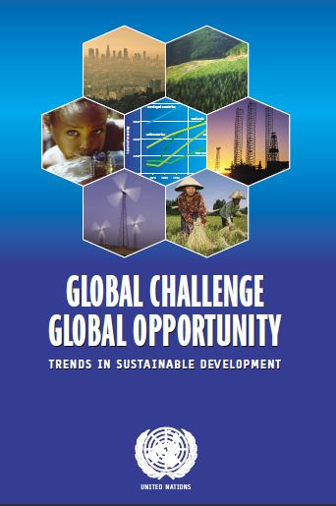
Trends in Leading Indicators of Sustainable Development

Slide 13
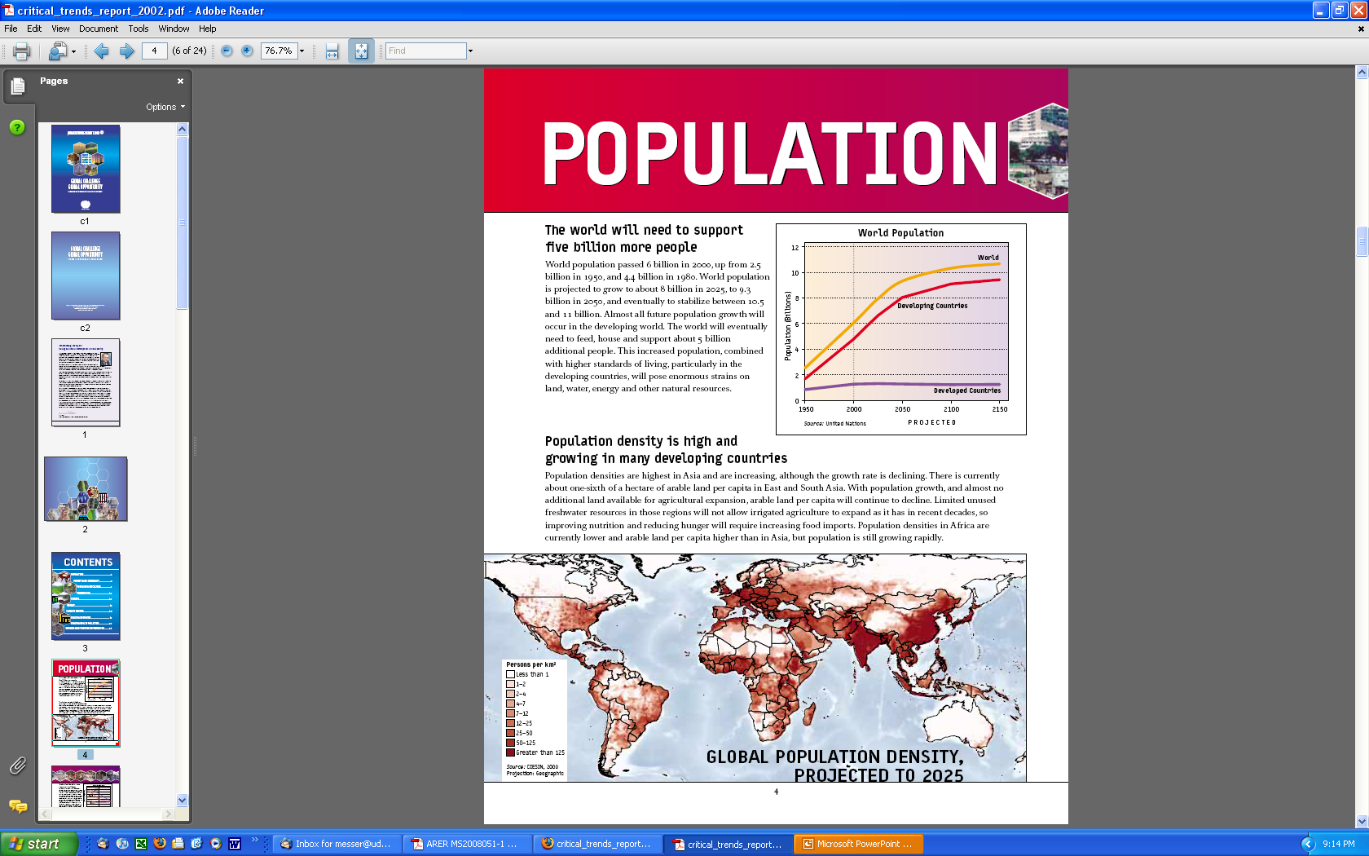

Slide 15
Largest 20 Cities in the World (Source: World atlas, 2009)
1. Tokyo, Japan - 28,025,000 2. Mexico City, Mexico - 18,131,000 3. Mumbai, India - 18,042,000 4. Sáo Paulo, Brazil - 17,711,000 5. New York City, USA - 16,626,000 6. Shanghai, China - 14,173,000 7. Lagos, Nigeria - 13,488,000 8. Los Angeles, USA - 13,129,000 9. Calcutta, India - 12,900,000 10.Buenos Aires, Argentina - 12,431,000
11. Seóul, South Korea - 12,215,000 12. Beijing, China - 12,033,000 13. Karachi, Pakistan - 11,774,000 14. Delhi, India - 11,680,000 15. Dhaka, Bangladesh- 10,979,000 16. Manila, Philippines - 10,818,000 17. Cairo, Egypt - 10,772,000 18. Õsaka, Japan - 10,609,000 19. Rio de Janeiro, Brazil- 10,556,000 20. Tianjin, China - 10,239,000

Slide 16
Populations of other cities of interest
(Source: World Atlas, 2009)
22. Paris, France - 9,638,000 24. Moscow, Russia - 9,299,000 25. London, UK - 7,640,000 27. Tehrãn, Iran - 7,380,000
29. Chicago, USA - 6,945,000 36. Hong Kong, China - 6,097,000 47. Baghdãd, Iraq - 4,796,000 50. Toronto, Canada - 4,657,000 53. Philadelphia, USA - 4,398,000 55. Milano, Italy - 4,251,000
59. Madrid, Spain - 4,072,000 60. San Francisco, CA - 4,051,000
62. Washington DC, - 3,927,000 63. Houston, TX - 3,918,000 64. Dallas, TX - 3,912,000 65. Guadalajara, Mexico - 3,908,000 68. Detroit, MI - 3,785,000 81. Montréal, Canada - 3,401,000 100. Napoli, Italy - 3,012,000

Slide 17
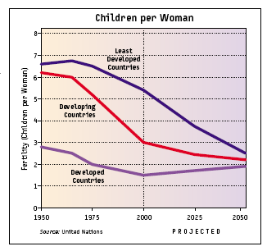
Family Size is Decreasing

Slide 18
Earth’s Basic Land Uses
~70% of the Earth is water
3% of that is fresh water
~30% of the Earth is land
Agriculture (11%)
Pasture (24%)
Forest/woodland (31%)
Remainder (34%)
Desert, glacier, high mountains, urban
3-4% in buildings, roads, parking lots, and other infrastructure

Slide 19
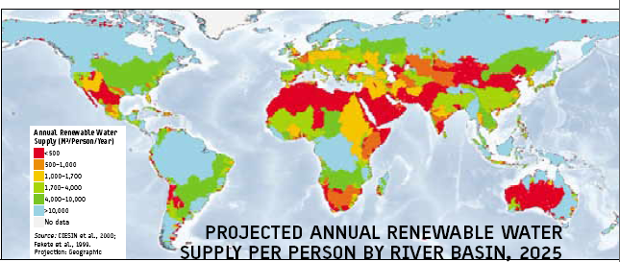
Water Shortfalls

Slide 20
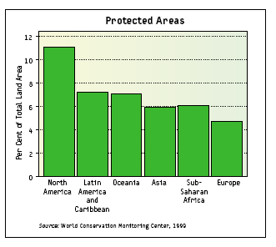
Protected Areas are Increasing

Slide 21
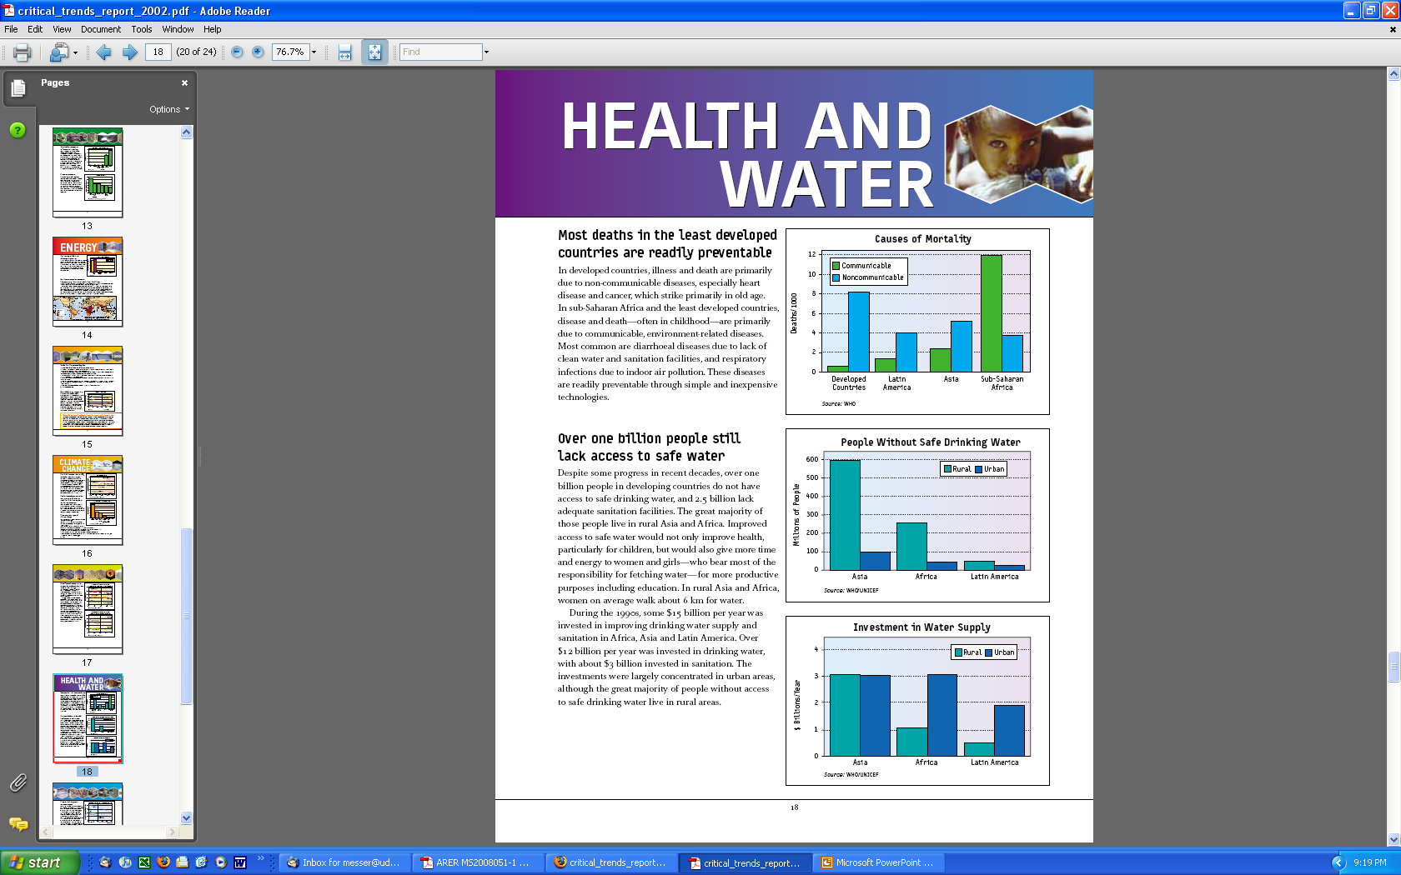

Slide 23
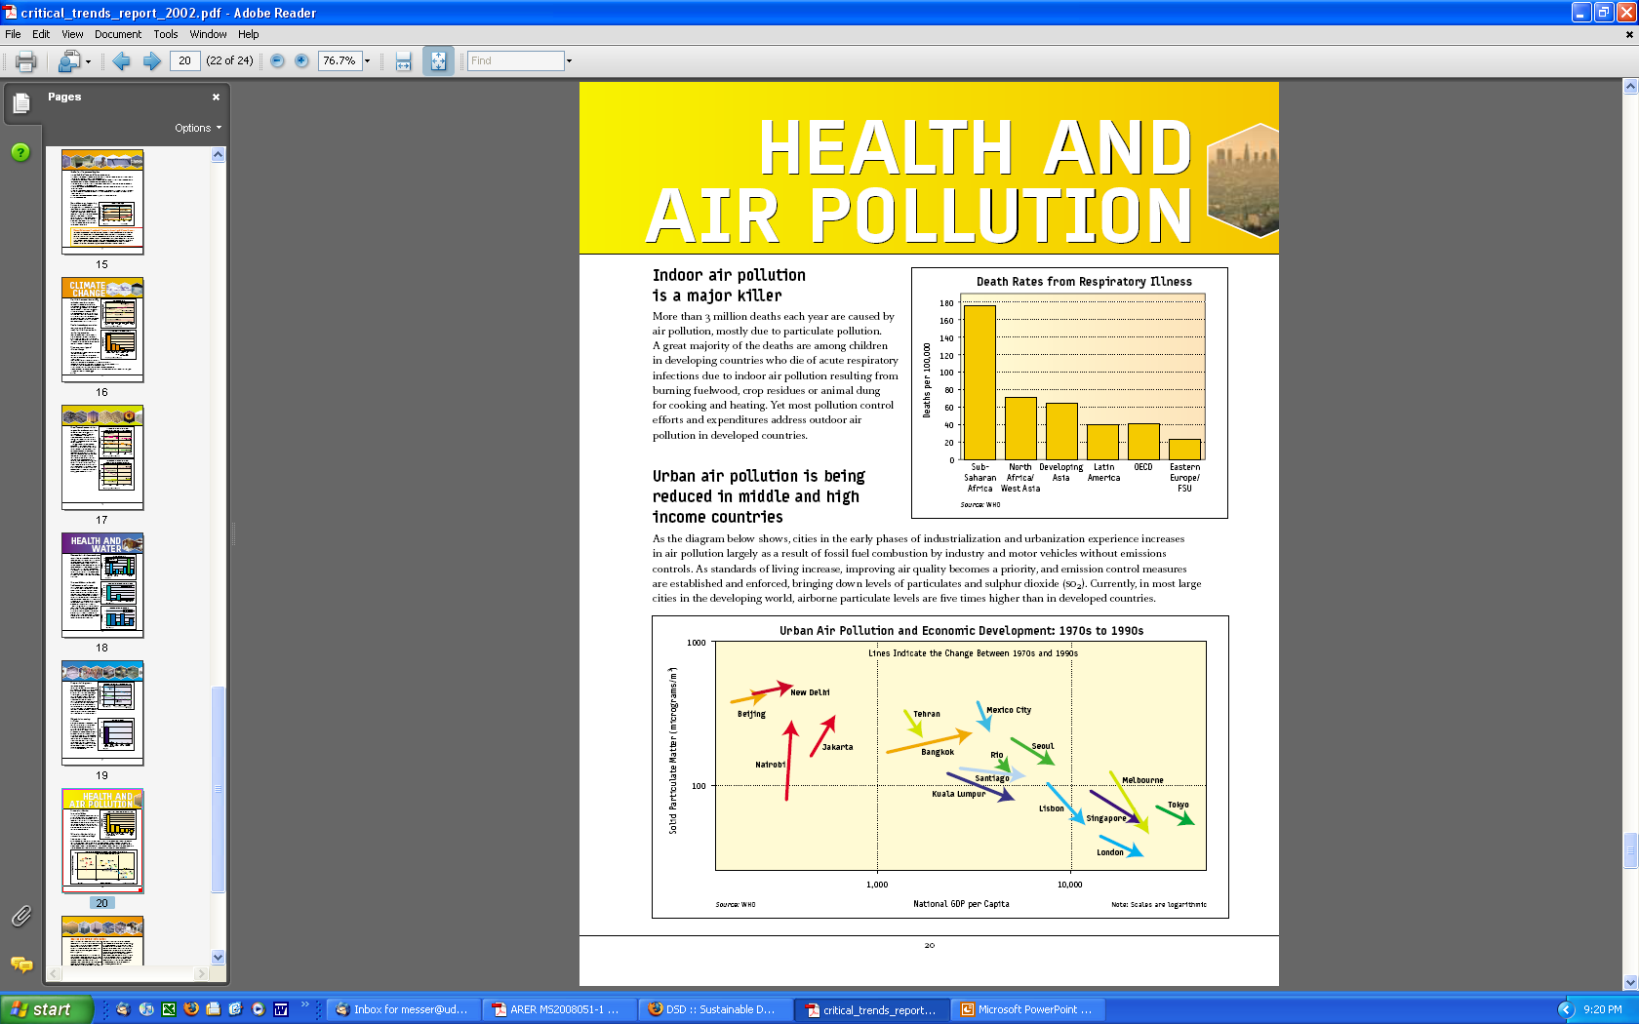

Slide 24
Air Pollution is Improving

Slide 25
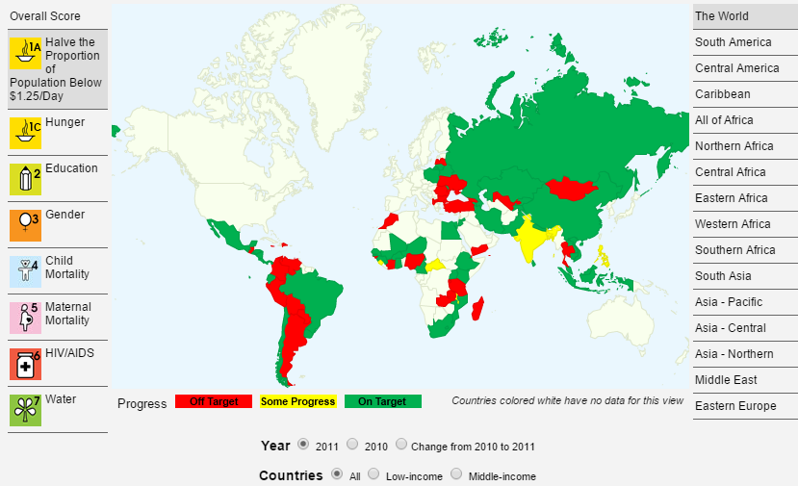
Millennium Development Goals: Country-Level Achievements
www.cgdev.org/page/mdg-progress-index-gauging-country-level-achievements

Slide 26
Millennium Development Goals: Country-Level Achievements Poverty
www.cgdev.org/page/mdg-progress-index-gauging-country-level-achievements

Slide 27
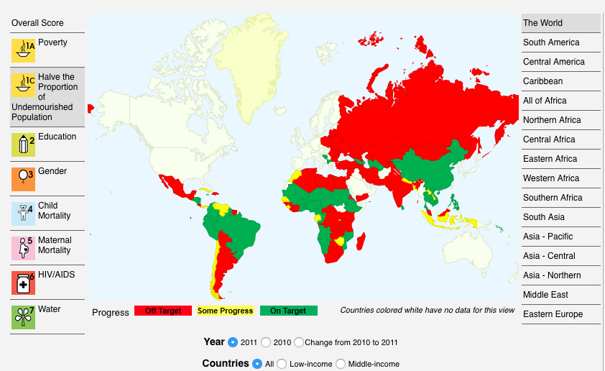
Hunger
http://www.cgdev.org/page/mdg-progress-index-gauging-country-level-achievements

Slide 28
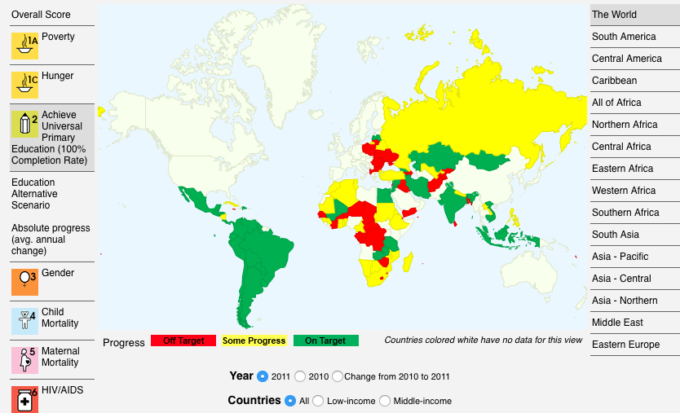
Education
http://www.cgdev.org/page/mdg-progress-index-gauging-country-level-achievements

Slide 29
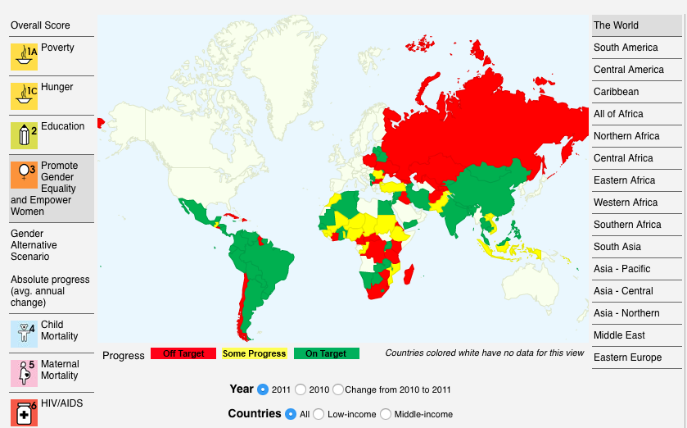
Gender
http://www.cgdev.org/page/mdg-progress-index-gauging-country-level-achievements

Slide 30
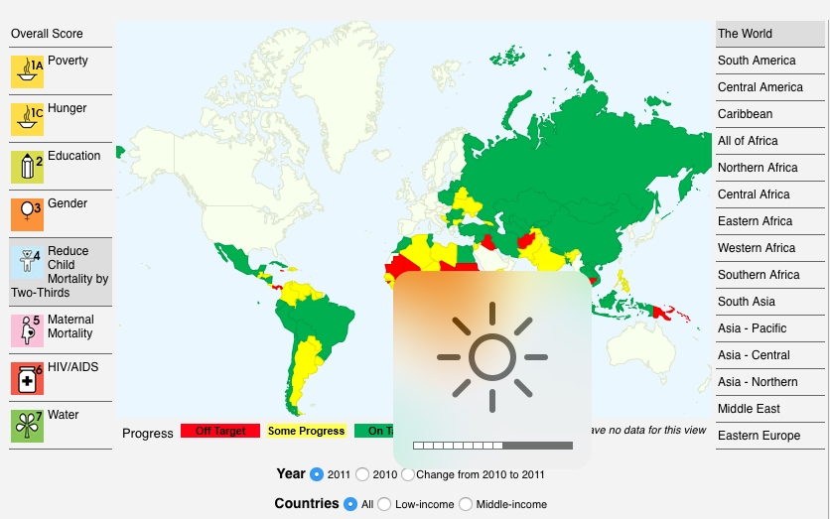
Child Mortality
http://www.cgdev.org/page/mdg-progress-index-gauging-country-level-achievements

Slide 31
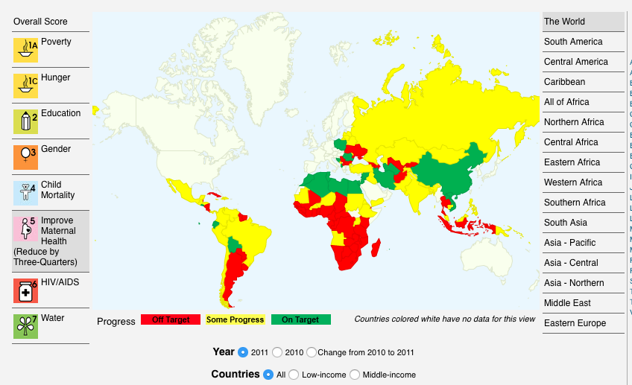
Maternal Mortality
http://www.cgdev.org/page/mdg-progress-index-gauging-country-level-achievements

Slide 32
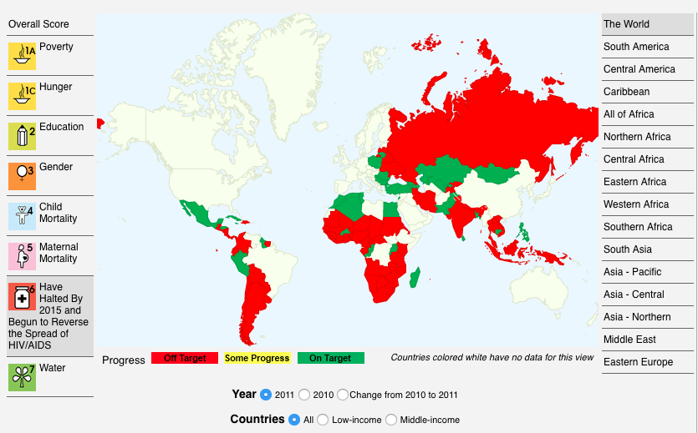
HIV/AIDS
http://www.cgdev.org/page/mdg-progress-index-gauging-country-level-achievements

Slide 33
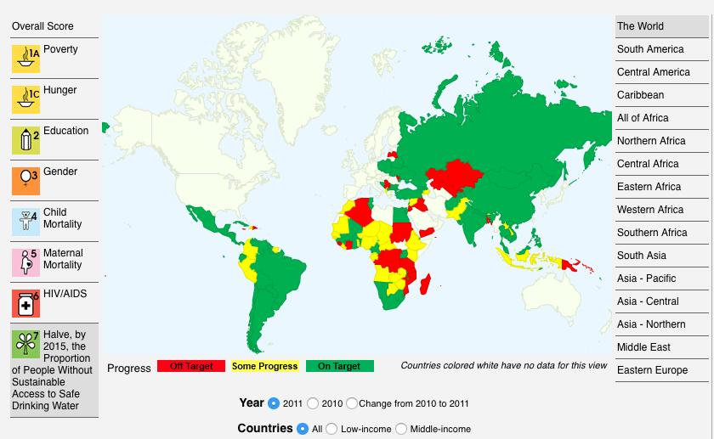
Water
http://www.cgdev.org/page/mdg-progress-index-gauging-country-level-achievements

